Slide 1

Françoise VAN DE VEN,
Chairlady ATIBT – INTERNATIONAL TECHNICAL ASSOCIATION OF TROPICAL TIMBER www. atibt.org – francoise.vandeven@atibt.org
GLOBAL LEGAL AND SUSTAINABLE TIMBER FORUM 2023 – MACAU 22/3/2023
Seminar on She Power in the sustainable development of Global Timber Industry
She power to create a new future together

Slide 2
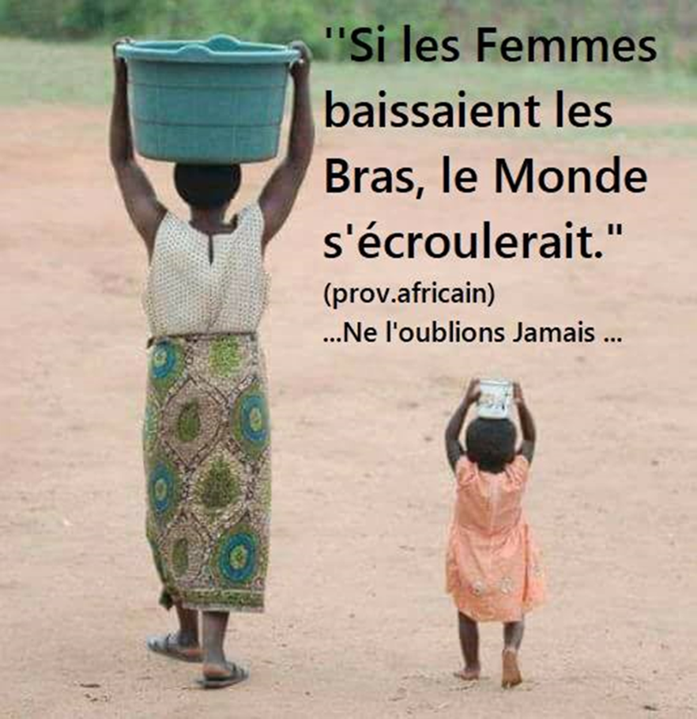
« If women gave up, the world would fall apart »
African Proverb
Let us never forget that ….

Slide 3
My career
Active in timber sector since 1979 till 1997 in Belgium (VAN HUFFEL NV and KREGWOOD)
From 1997 till 2005 management of timber companies in Democratic Republic of Congo (SOKINEX and SAFBOIS)
From 2005 till 2015 Secretary General of FIB – National Federation of the timber sector in Democratic Republic of Congo
From 2015 to 2021 – Secretary General of UFIGA, National Federation of the timber sector in Gabon
Elected on 28 January 2022 as President of ATIBT – INTERNATIONAL TECHNICAL ASSOCIATION OF TROPICAL TIMBER.

Slide 4
Today’s timber sector
Wood is an extraordinary raw material, especially tropical wood, incredible colors and textures
Being a renewable natural resource with the capacity to store carbon and thus contribute to the fight against global warming
Exploiting the forest has changed a lot in the last few decades and now involves requirements/obligations on sustainable management, reduced-impact logging, traceabality,environmental requirements, internal and external social responsibility, rural development projects with local communities, wildlife management and anti-poaching, all this in order to ensure the sustainability of the resource for future generations

Slide 5
What role can women play in today’s timber sector
Women by nature:
as tropical wood is not only highly valued for its durability, but also very decorative, a woman's sense of color and harmony is a real asset in the design of furniture, infrastructure, interior decoration
can easily understand and appreciate human beings, feel concerns and needs. The management of internal (staff) and external (local communities) social aspects require a special attention
are very important in creating a respectful environment quality which is also very developed in the genes of women. Are we not in our daily occupations responsible for a large part of our households, families, homes in this context?

Slide 6
Difficulties, challenges, opportunities...
Important not to be discouraged because the mastery of the work will allow to evolve while remaining persevering
And yes, there will always be men who will not appreciate women in top positions, but there will also be men that will support you, and even push you to the top
When hiring personnel, in case of equal capacities you must chose women over men, but not just hire a person because it is a woman. At the end you will have to rely on this person as your collaborator
There are still glass ceilings ... but we are making progress.... Over the past decade, important positions have been held by women.
Fair wages are still frequently a problem
As a leader/manager a woman will need to be strong, taking into consideration all aspects of her task and create a good team around her so that her management is a success

Slide 7
Finally, another African proverb: "when a woman is chosen to head the village, it means that the men before her have failed".
Thank you for your attention !

